Slide 1
Forms is Dead – Really ?
Jürgen Menge (Der IT-Macher GmbH, Germany)

Slide 2
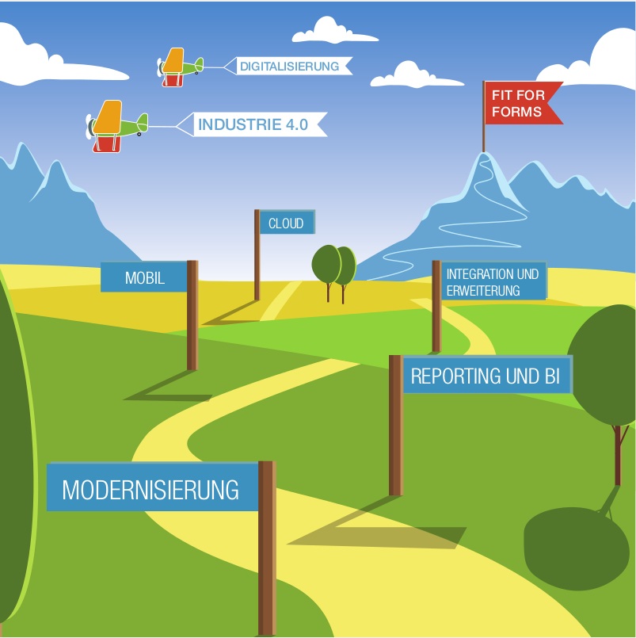
Der IT-Macher GmbH
  Founded in April 2016
  Comprehensive Oracle expertise
  Average age 40+
  IT consultancy
  Primary customer base: Oracle Forms user
  Technical competency
    Oracle Forms
    Oracle APEX
    Java/Oracle ADF
    Oracle Jet
    Mobile
    Cloud

Slide 3

Forms is Dead – Really ?

Slide 4
















Definitely not, because ...
2000+ German customers using it
Business critical applications rely on it
Oracle E*Business Suite is based on it
New releases with new features
...

Slide 5
Oracle Forms
Support Note 2009262.1: Oracle Forms Statement of Direction (31.08.2017)
"Oracle continues its commitment to Oracle Forms. New releases are being planned and new features and other improvements are currently being reviewed. New releases are planned to include some of the following, as well as many others:
  Design-time productivity improvements
  Performance improvements
  Client configuration improvements
  New and enhanced object properties
  New runtime UI features
  New and improved integration with various products and technologies
  Support for new Java versions
  Support for new operating systems
  And many more…"

Slide 6

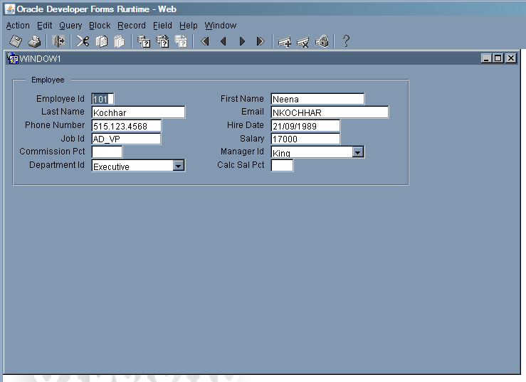
But there are 2 Threats
The future of Java on the desktop
A lack of modernization and
missing user acceptance

Slide 7
Java Client Roadmap
JDK 9 and the Java-Plug-in
"Oracle has deprecated the Java browser plugin in Java Standard Edition Development Kit 9 (JDK 9)."
https://www.java.com/en/download/faq/jdk9_plugin.xml
Roadmap for Java Applet / Java WebStart / Java FX
In Java SE 8
Deprecated in Java SE 9
Will be removed in Java SE 11
http://www.oracle.com/technetwork/java/javase/javaclientroadmapupdate2018mar-4414431.pdf
Alternatives
Java Platform Module System with command jlink
Third-party deployment solutions (like frmsal vom Oracle)

Slide 8
Which Java Version Should I Take ?
http://www.oracle.com/technetwork/java/eol-135779.html
Java 8
Updates
  Download updates for commercial usage until January 2019
  Public (non-commercial) updates until December 2020
  Updates for Forms customers via patch 18143322 (Note 2310266.1)
Support
  Premier support until March 2022 / Extended Support until March 2025
  At least until the end of support for Forms 12c (12.2.1.3)
  Exceptions for web deployment (Java Plug-In, WebStart)
Java 9 / Java 10
Non-LTS versions (6 months)
Not certified for Oracle Forms
Java 11
Published in September 2018
LTS version
Notes:
6-monatiger Release-Zyklus
LTS-Versionen alle 3 Jahre

Slide 9
Licensing of Java
Oracle Java SE Subscription required for commercial use of Java starting 2019
  Entitlement for support and updates
  Free of charge only for development, test, prototyping and demonstration purposes
  Alternative Open JDK can be used
What does it mean for Oracle Forms customers ?
  Note 1557737.1 -
  Support Entitlement for Java SE When Used As Part of Another Oracle Product
  Java components can be used when
    they were developed with the JDK installed as part of Oracle Forms
    they will be used as part of the Forms application
    https://www.oracle.com/corporate/pressrelease/java-se-subscription-offering-062118.html
    https://www.oracle.com/technetwork/java/javaseproducts/overview/javasesubscriptionfaq-4891443.html

Slide 10
Oracle Forms 12.2.1.x
Options for client runtime
Applet embedded in HTML
  SSO, SSO logout and JavaScript integration
  Java Plug-In and browser required
JNLP embedded in HTML
  SSO, SSO logout and JavaScript integration
  Java Plug-In and browser required
  JNLP code in HTML source code
Java WebStart
  SSO (if initiated in browser)
  no support for SSO logout and JavaScript integration
  JDK or Java Plug-In required
Standalone
  No support for SSO, SSO logout and JavaScript integration
  JDK or Java Plug-In required
  Browser not required
  Forms Standalone Launcher (FSAL)

Slide 11
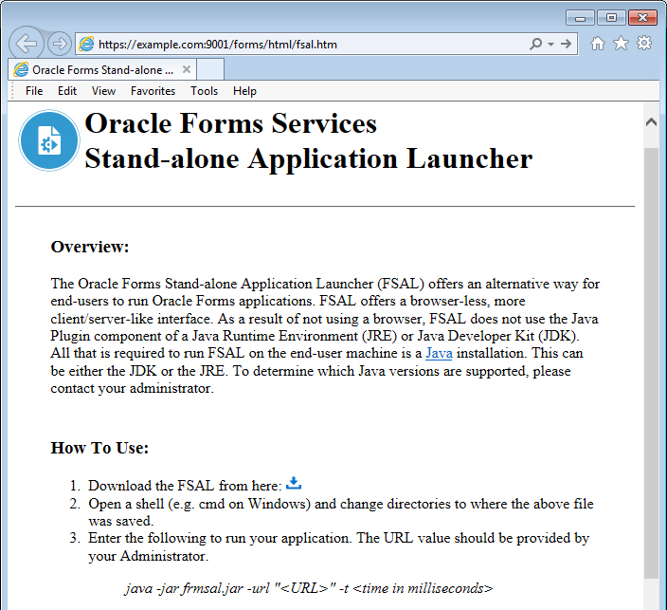
Forms Standalone Launcher (FSAL)
Download Link
http://example.com:9001/forms/html/fsal.htm

Slide 12
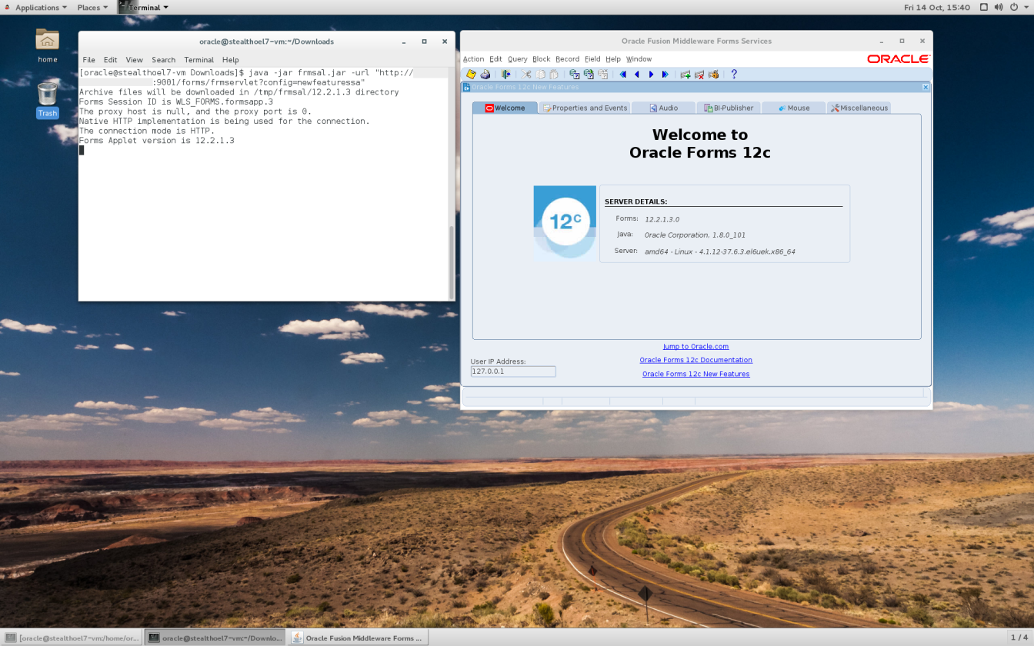

Slide 13
Forms Standalone Launcher (FSAL)
Only future-proof option for the client runtime
  Oracle Support Note 2310266.1
  "On a case by case basis, Java versions beyond v9 (e.g. 18.x and newer) will be considered for certification with Forms 12+, but only for use with the Forms 12.x Standalone Launcher (FSAL)."
  Platform-specific (version depends from server OS)
Uses command java or javaw to start the launcher
  Arguments are documented
    https://docs.oracle.com/javase/8/docs/technotes/tools/windows/java.html
  Example
  java -jar frmsal.jar -url "http://jmenge-de.de.oracle.com:9001/forms/frmservlet?
  config=standaloneapp" –t 10000

Slide 14
Forms Standalone Launcher (FSAL)
Configuration
Configuration files
  General configuration in formsweb.cfg
  Instead of baseHTML file
    baseSAAfile=basesaa.txt (without Webutil)
    baseSAAfile=webutilsaa.txt (with Webutil)
  Recommended: define parameters in formsweb.cfg and reference them in text file (%param%)
Configuration of proxy possible
  -Djava.net.useSystemProxies=true
Launcher does not log into a file
  Output will be sent to the shell FSAL was started from
  Redirect of output into a file is possible:
    java –jar frmsal.jar –url “http://example.com/forms/frmservlet?config=standaloneapp” > c:\fsal.txt

Slide 15
Forms Standalone Launcher (FSAL)
Caching
Caching of jar files and DLLs on the client !!
  Works since Forms 12.2.1.3
jar files
  FSAL has its own cache
  jar files will be stored beneath the directory %tmp%
    Example: %tmp%\frmsal\localhost\12.2.1.3
  Recommendation
    Set parameter COMPUTERNAME in default.env
    Set %tmp% to %userprofile%
DLLs (only MS Windows)
  DLLs will be stored in user profile

Slide 16
Forms Standalone Launcher (FSAL)
Security
Managing JAR files
  Implicit checksum check between versions on server and client
  Called file on the client should be equal to the file on the server
  Default: No certificate check => signing of jar files not required !!
  If frmsal will be started with Security Manager (-Djava.security.manager) => Check of certificates
Managing DLL files
  Check of DLL size and compared with settings in webutil.cfg only at initial load
  At startup only the file webutil.xxx.properties in user's profile will be checked
  Security gap => if necessary explicit check should be programmed !
For SSL required certificates have to be imported in the keystore of Java instance used by FSAL
    http://www.oracle.com/technetwork/developer-tools/forms/documentation/fsal-security-4438382.pdf

Slide 17

Forms Standalone Launcher (FSAL)
Recommendations
Use an isolated Java Runtime on the client
  JDK, JRE or Server JRE
Use a version of Java recommended for Oracle Forms
Test forms module in browser or with frmsal and java.exe (with console)
Run forms in production with frmsal.jar and javaw.exe (without console)
Optionally create an installable package (Microsoft Installer)
Create shortcuts for Forms applications on the desktop
Run Forms in secure environment
  Run Forms only in intranet
  Protect archives and DLLs on the server
  Create and sign an exe-file to launch Forms applications

Slide 18
Threat: Modernization gap and missing user acceptance
Customers complaining about old-fashioned look&feel
Functional enhancements and modernizing the look&feel
  Improve user acceptance
  Increase productivity
  ...
Ways of modernization
  Using "native" features of Oracle Forms 12c
  Adding external components (Java)
Modernizing an application means that the life cycle will be extended !

Slide 19

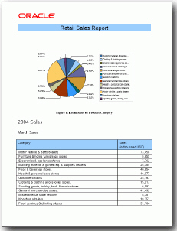
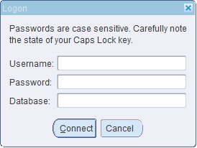
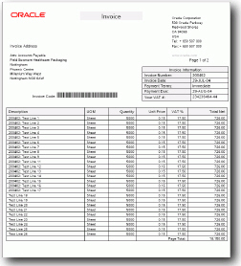
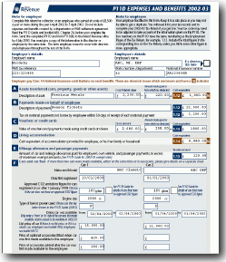


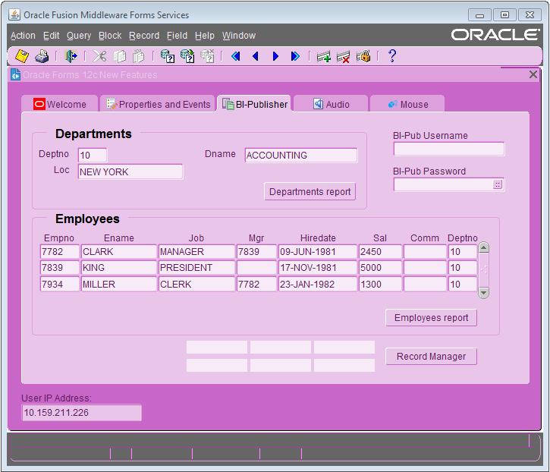
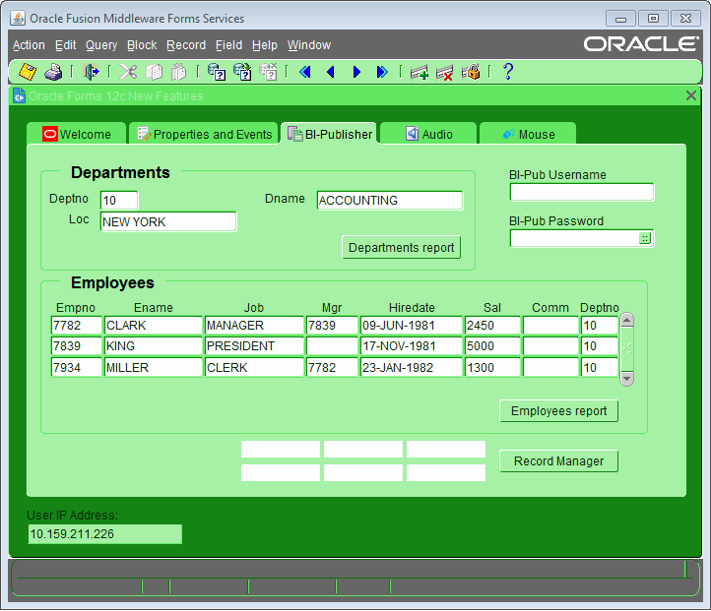
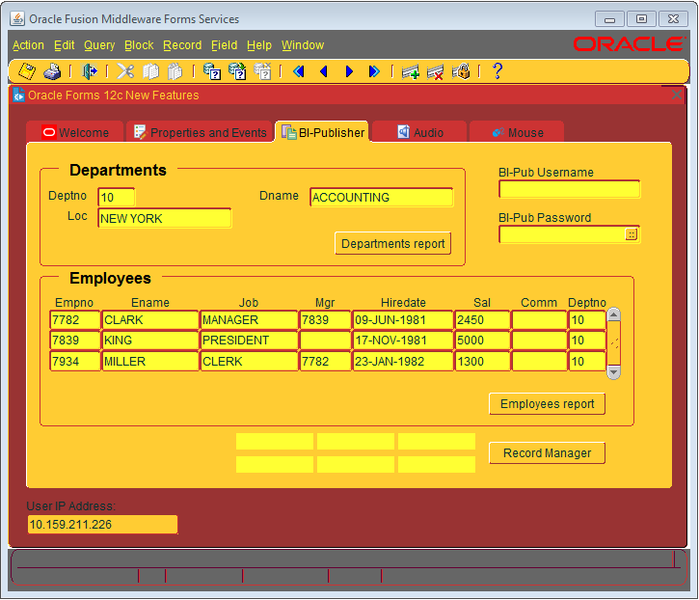
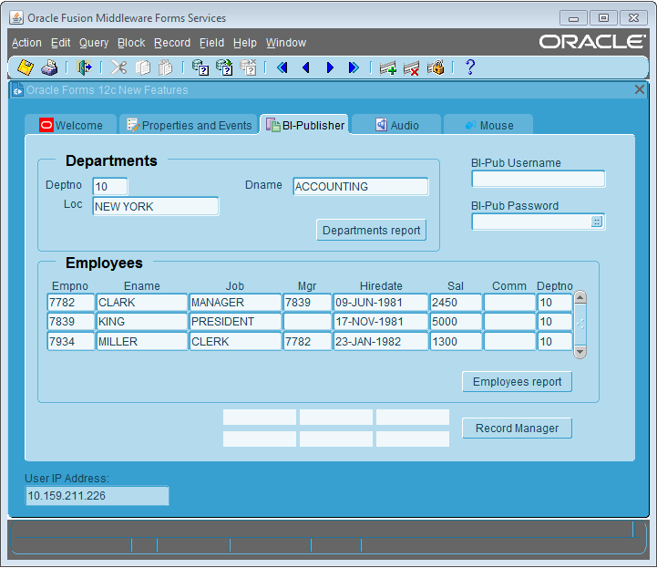

Native Features in Forms 12c
Tabs with Icons
BI Publisher Integration
Login Hints
Java WebStart
Audio Playback
Customizable Color Schemes
System Events
DB-Idle
Client-Idle
Notification
Single-Sign-Off
Media Completion
Item Level Mouse Pointers

Slide 20
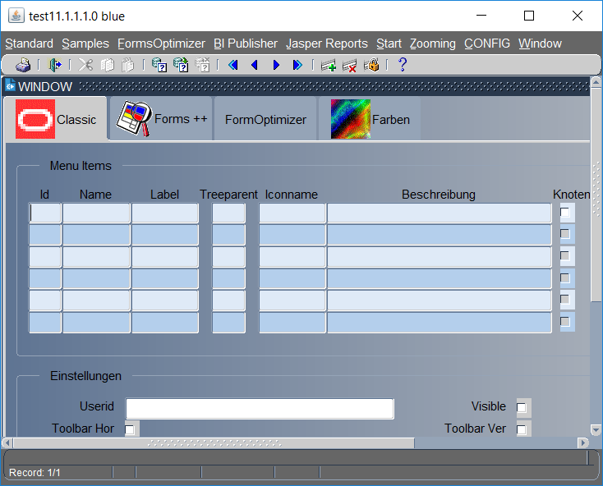
Improving the Look&Feel
Native Features of Oracle Forms 12c
  Custom Color Schemes
  Gradient Color Canvas
  Row Banding
  Toolbar Sizing
  ...
Notes:
Demo-Form mit Gradient Color Canvas und Row Banding

Slide 21
Using a Custom Color Scheme
https://example.com/forms/frmservlet?customColorScheme=myblue

Slide 22
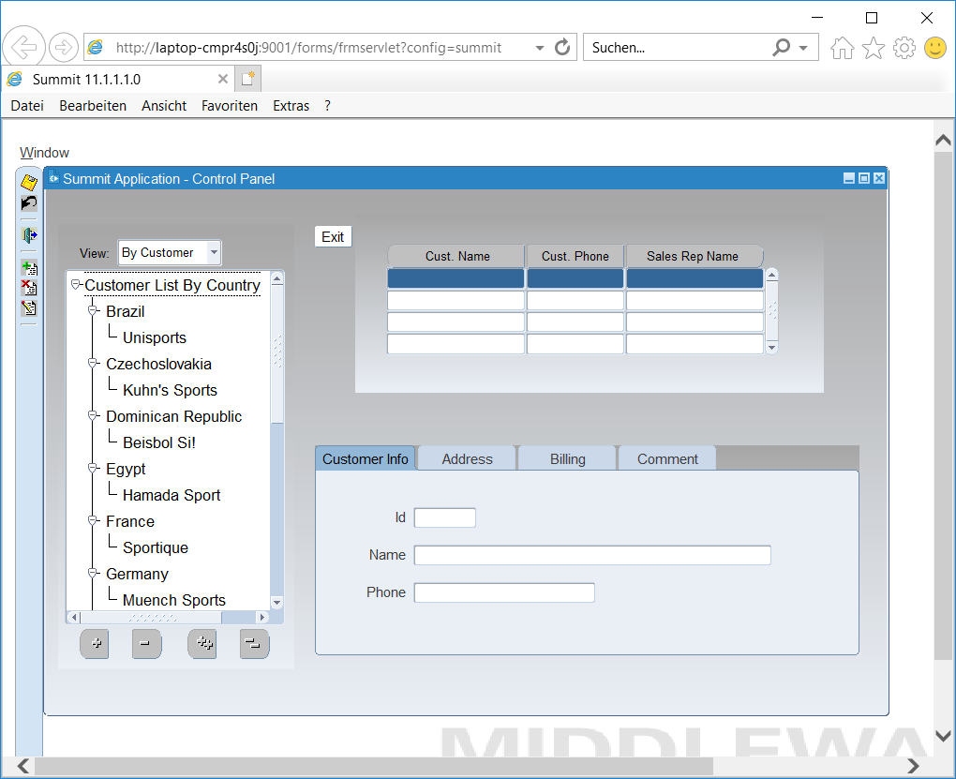
Forms 12c – Gradient Color Canvas
Gradient Color Canvas
  Property Gradient Start Side
  for canvases (declarative)
  Colors will be defined by color scheme
  Degree of change (gradient) will be
  defined in registry.dat

Slide 23
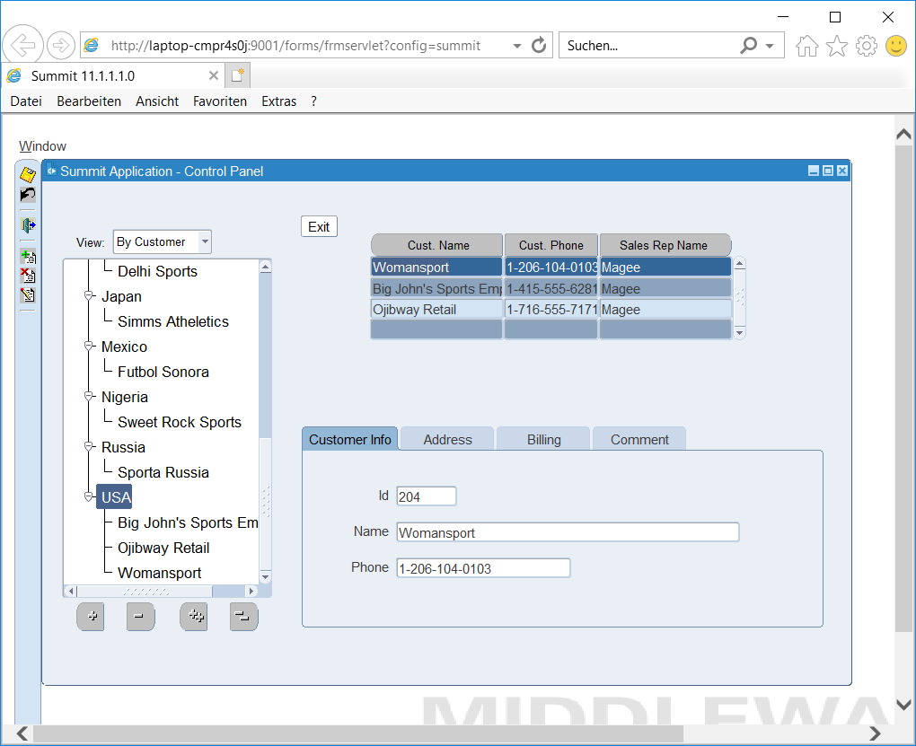
Forms 12c – Row Banding
Row Banding
  Property Row Banding Frequency on block and item level (declarative)
  Definition on block level is valid for all items except it is defined differently on item level
  Colors are defined by color cheme
  Colors stay when scrolling through records
  Not in combination with background color on item level

Slide 24
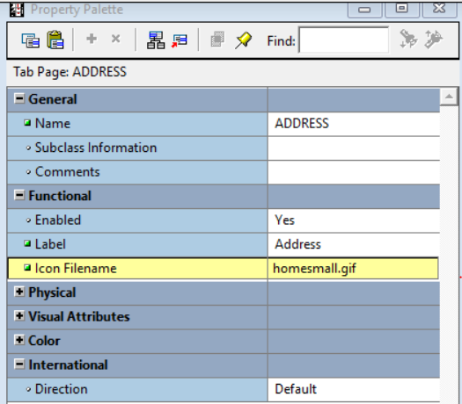
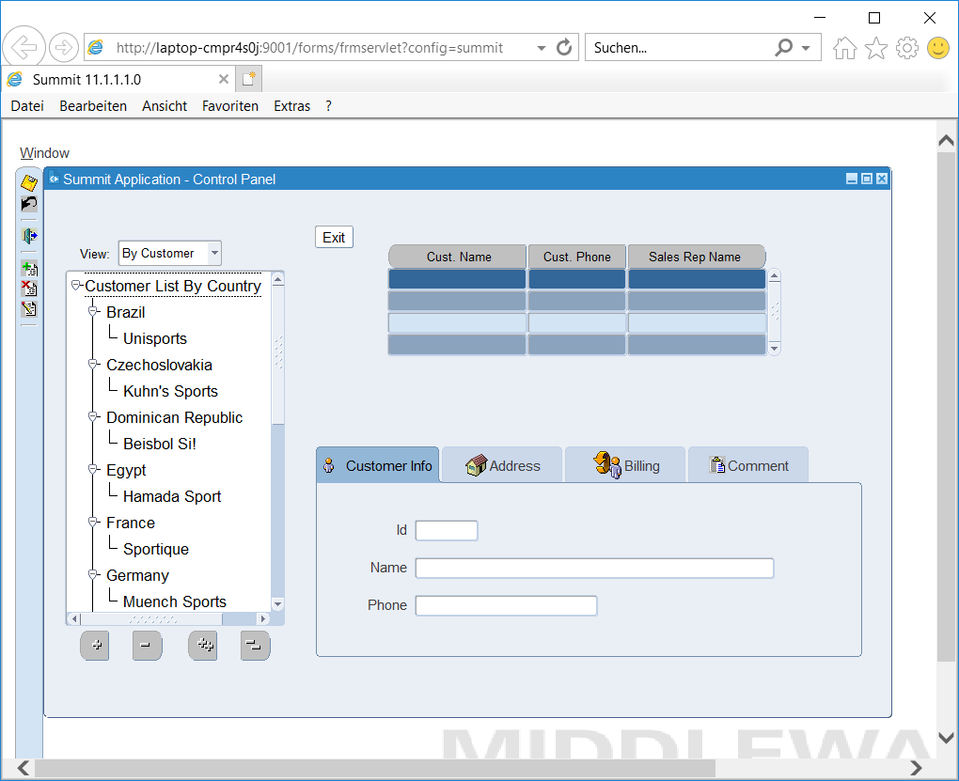
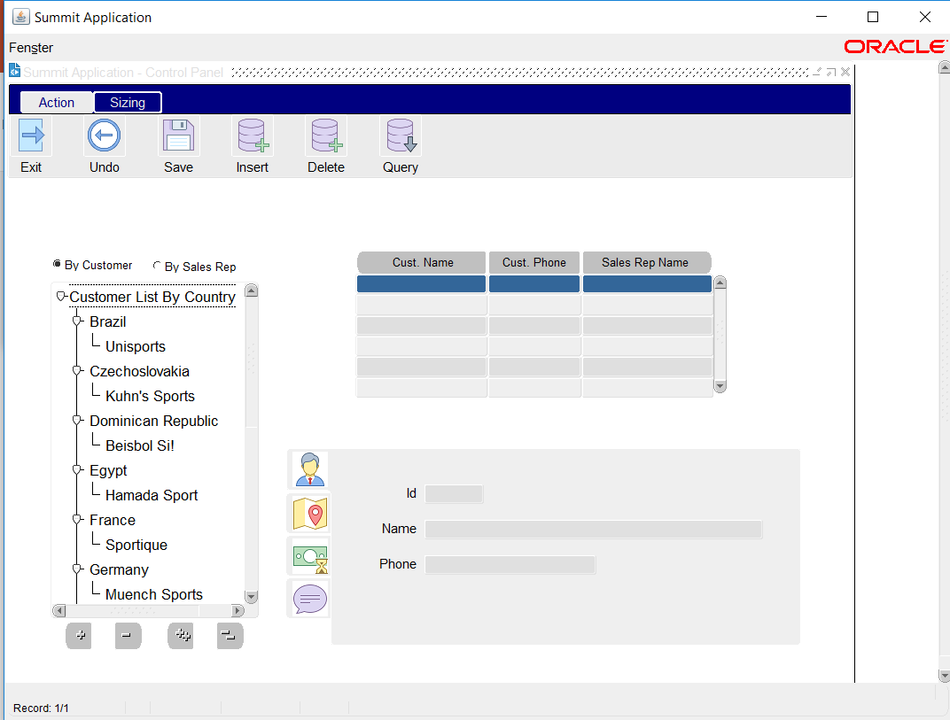
Forms 12c – Tab Icons
Deployment of icons as in the past
Declarative: Property Icon Filename of a tab page
Programmatically: SET_TAB_PAGE_PROPERTY
(‚ADDRESS‘,ICON_NAME,…)

Slide 25
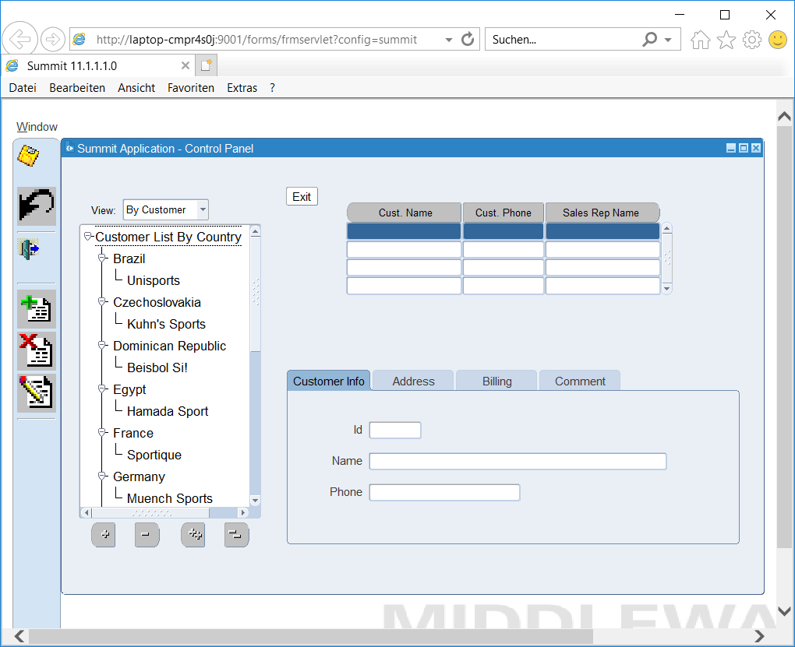
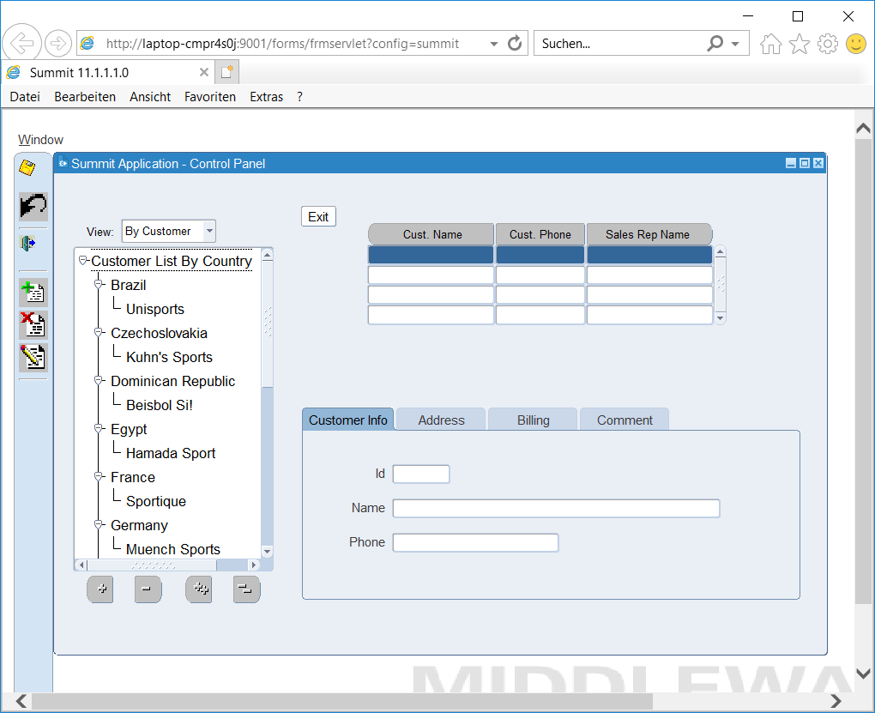
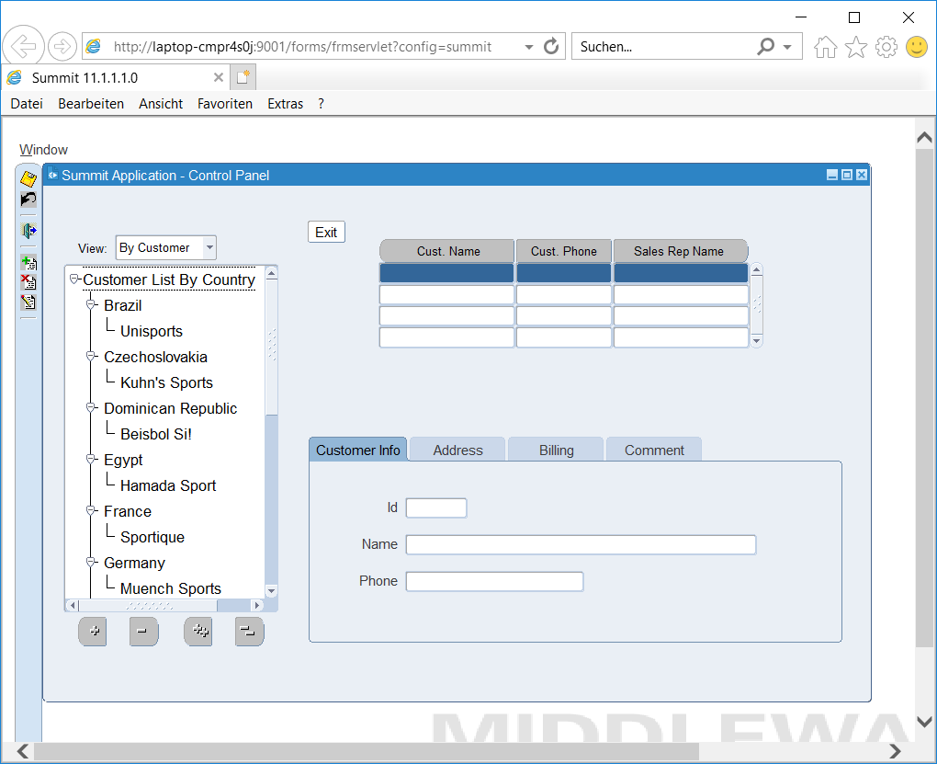
Forms 12c – Toolbar Sizing
Applet parameter smartBarHeight
  Normal (Def.) 16x16
  Medium 32x32
  Large 48x48
  Dynamic depends from clientDPI
Small icons will be magnified
Large icons will be cropped
Smartbar icons will not be
touched !!

Slide 26

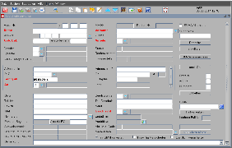
Adding External Components - FormsOptimizer
  Integration
  Integration of Mail Client
  Browser Integration
  Web Services
  Handling
  Focus Indicator
  Date Picker
  Display Function Keys
  Integrated LOV Buttons
  Checkbox in Query Mode
  Navigation
  Context Menu with Navigation
  Look
  Application Scaling
  Size-optimized Images
  Diagrams
  Progress Bar
  HTML-formatted Text Items
  Support
  Initiate Remote Control
  Client Check
  Display of Properties
  Additional Functionality
  File Selection
  Extended Alerts
  Table Grid
  Export to Excel
  Multiline Selection and Editing
  Display can be configured and stored
Notes:
Sprungziele
Skalierung (siehe dpi)
Bearbeiten

Slide 27

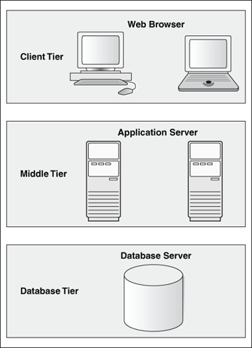
Technical Overview
Requirements & Architecture
  Pluggable Java Components
  Java Beans
  Client check
Oracle Forms
  10g, 11g or 12c
Client-site Java (JRE)
  Java 8+ for BrowserBean
  Java 7+ for JTable
  Java classes
  Configuration files
  jar archives
  Schema data (Metadata, Sample)
  Program units (Packages)

Slide 28
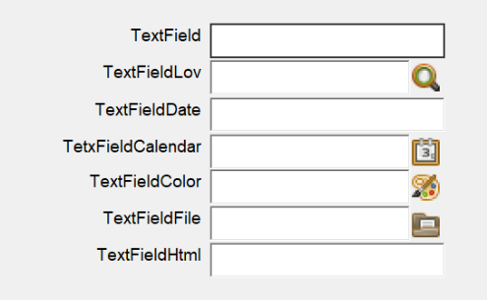
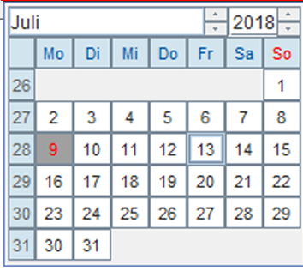
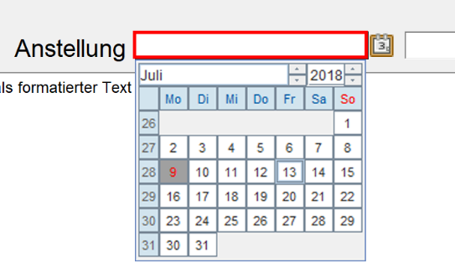
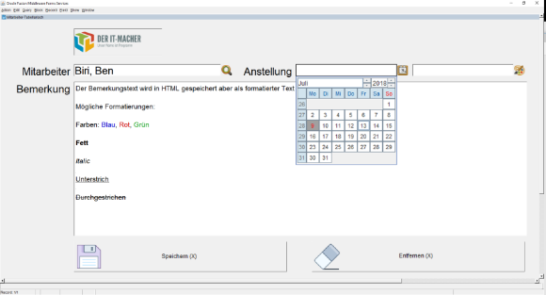

FormsOptimizer - Look
Numerous options for an attractive design
Integrated LOV buttons
Date picker
Focus indicator
Button layout

Slide 29
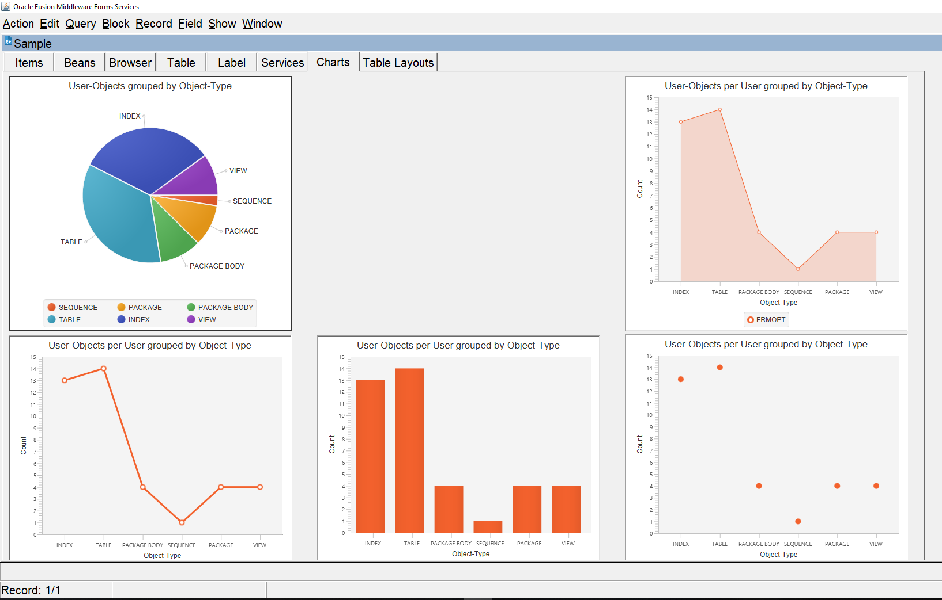
FormsOptimizer - Look
Diagrams
Integration of diagrams into Forms screens
Simple analytics embedded into the application
Implementation: JavaFX charts

Slide 30
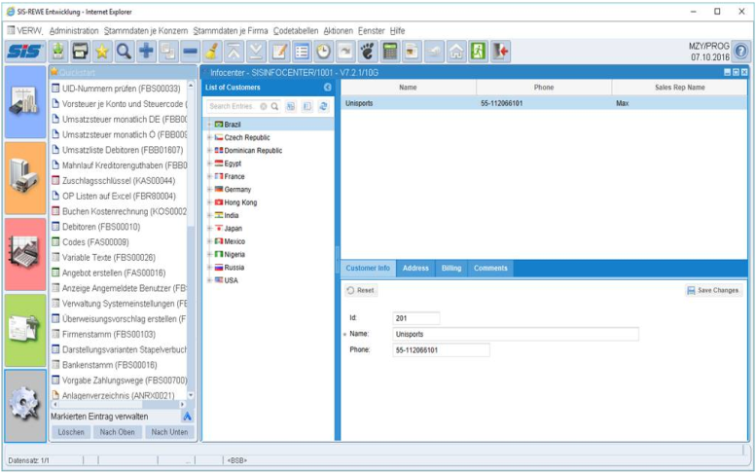
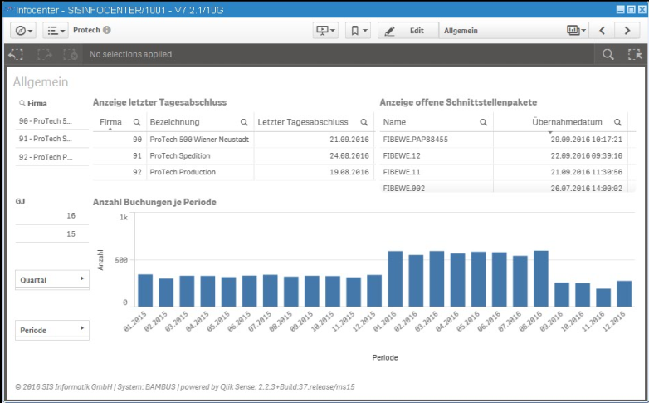
FormsOptimizer – Integration
Browser Bean
Embedded web browser to present additional content
Possibilities
  Display of maps
  Running web applications (Oracle APEX, Oracle JET, ...)
  Integration of charts from BI applications
Implementation: integrated JavaFX browser

Slide 31
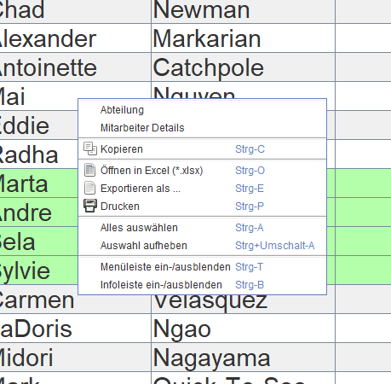
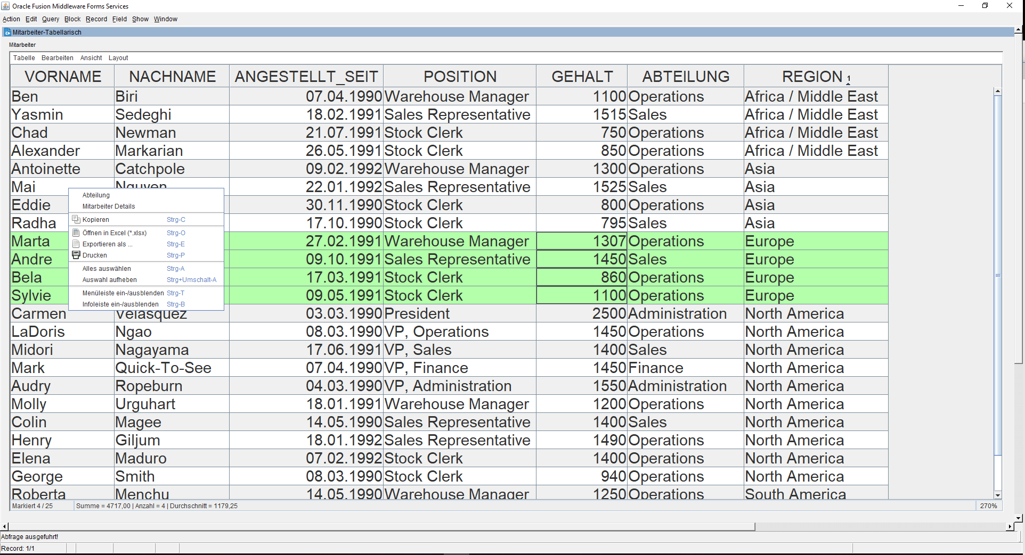
FormsOptimizer - Table Grid
Context Menu and Export to Excel

Slide 32

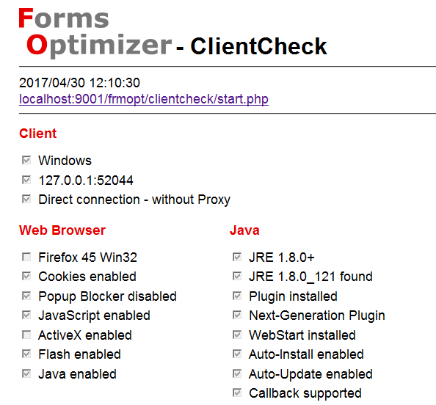
FormsOptimizer - Support
Client Check
Check of client-site configuration
Configurable checklist for required components and settings
  Operating system
  Browser (version, settings, plug-ins, ...)
  Proxy server
Check before login or during the session
Helps support in error situations
Implementation:
PHP (independend from Oracle Forms)

Slide 33
Benefit
Benefit of FormsOptimizer …
Better user acceptance by the use of modern UI elements and functional extensions
Productivity of Forms development preserved
Usage of field-proven components
Low risk of Implementation
Reasonable investment of modernization
Continued development

Slide 34

German Oracle User Group (DOAG)
DOAG Conference at 20.-23. November in Nuremberg
https://2018.doag.org
DevCamp planned for the first quarter of 2019
https://devcamp.doag.org
DOAG Forms Day planned for the first quarter of 2019
https://www.doag.org/de/themen/development/forms/

Slide 35




Question & Answers
Jürgen Menge
juergen.menge@der-it-macher.de
juergen.menge@doag.org

Slide 36
Oracle Forms in the Cloud
Oracle Java Cloud Service (PaaS)
  technically possible, but not supported
Compute Service (IaaS)
  Support environment
  Future offering in marketplace possible
Database Cloud Service can be used as database for Forms and Reports

Slide 37
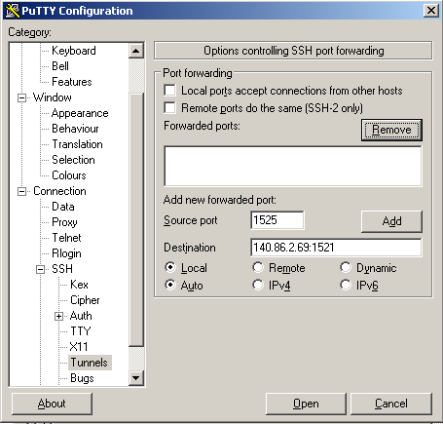



Oracle Forms and Database Cloud Service
Forms Server in internal network
DB in the cloud
Requirements
  SSH tunnel
  Or direct access to DB in the cloud
    Open port 1521 in the cloud firewall
    Open port 1521 for communication in the internal firewall
Customer Data Center
Forms
Client
Cloud Data Center
SSH Tunnel
Forms
Server
Database

Slide 38
The Future of Oracle Forms
Support Note 2009262.1: Oracle Forms Statement of Direction (31.08.2017)
  „With Cloud Computing being such an important part of today’s IT landscape, Oracle is investigating what possibilities the Cloud may offer for the Oracle Forms product and its customers. Using Oracle Forms in the Oracle Public Cloud could offer significant cost savings simply by reducing the typical cost of hardware upgrades and maintenance.”
  „Also a significant part of modern computing is mobile technologies. Working closely with Oracle Partners, Oracle will continue to investigate possible mobile solutions and how they may apply to an Oracle Forms customer.”

Slide 39

Demonstration
Forms Standalone Launcher
(FSAL)

